Slide 1
Customizable
Quick Start Guide
Templates

Slide 2
What’s included
Instructions
Slide 2: How to customize the templates
Quick start guide templates
Slides 3-5: Your first few days with Webex
Slides 6-7: Webex Calling
Slides 8-9: Webex Meetings
Slides 10-11: Webex Messaging

Slide 3
Instructions
Quick start guides help onboard users with key features right away. Make this template your own by adding your logo and brand colors or tailoring the messaging.
For Microsoft PowerPoint
Download the file
Save as a copy for version control
Add your logo: right-click “anycorp” image > Change Picture
Change the theme, background, or colors on the Design tab
Customize text as needed
Change an image: right-click > Change Picture
Change a hyperlink: right-click > Hyperlink > Edit Hyperlink
Hide any slides you don’t want to share: right-click > Hide Slide
Publish to PDF: File > Export > Export as PDF
For Google Slides
Download the file
Save as a copy for version control
Add logo: right-click “anycorp” image > Replace image
Change the theme or background on the Slide menu
Customize text as needed
Change an image: right-click > Replace image
Change a hyperlink: right-click > Link (or Ctrl+K)
Hide any slides you don’t want to share: right-click > Skip slide
Publish to PDF: File > Print preview > uncheck ”Include skipped slides" > Download as PDF

Slide 4




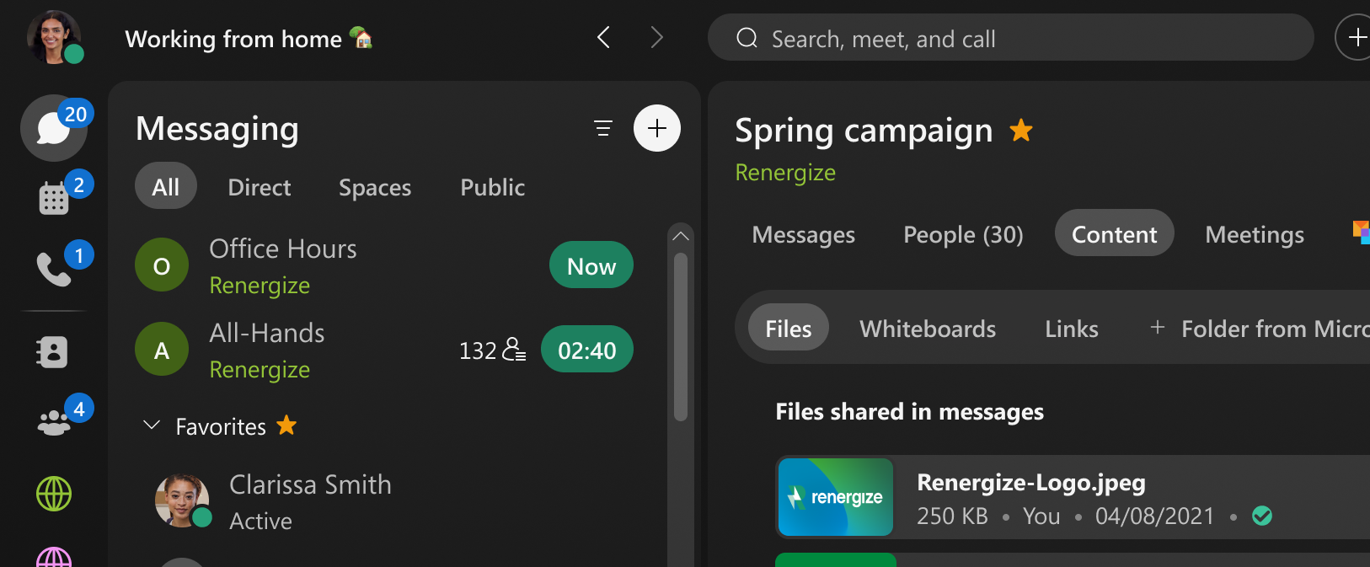
Your first few days with Webex
Switching between apps is a thing of the past. Welcome to Webex—where calling, meeting, and messaging come together in one workspace.
Download the app
and sign in
Set up your profile
and availability
Find your way
around the app
It only takes a few minutes to get started.
Download the Webex app to stay connected whether you're at your desk, moving between conference rooms, or working remotely. You can also download the Webex mobile app for when you’re on the go.
Sign in and you’ll be ready to start calling, messaging, and meeting.
A personalized profile helps others recognize and connect with you.
Click on your profile picture to:
Manage your availability
Set your status
Edit your profile
Adjust your settings
Your availability updates automatically during meetings and quiet hours to limit interruptions.
Tip: Connect your calendar to sync your out-of-office status automatically.
The left navigation gives you quick access to:
Messaging: Direct messages and spaces
Meetings: Start, schedule, and join
Calling: Dial pad and call history
Current meetings and notifications appear at the top to help you see what needs attention.
Download the app

Slide 5



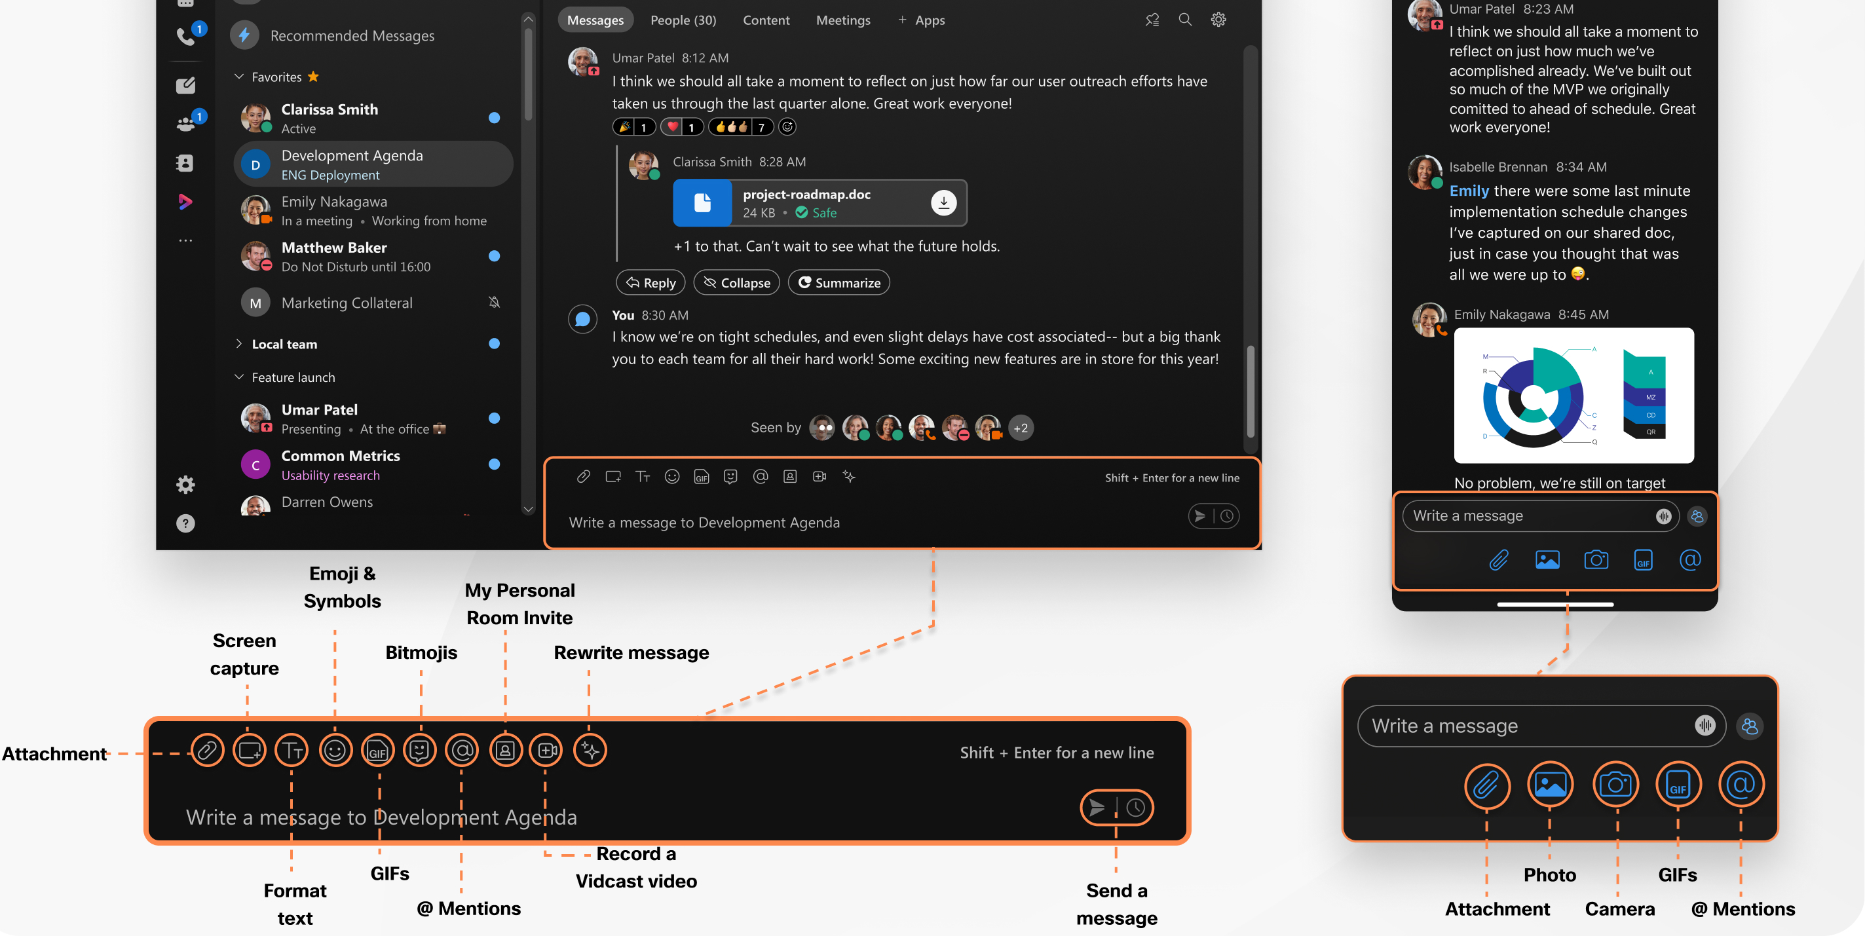
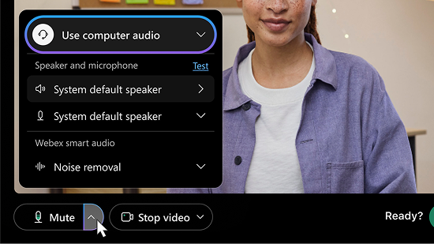
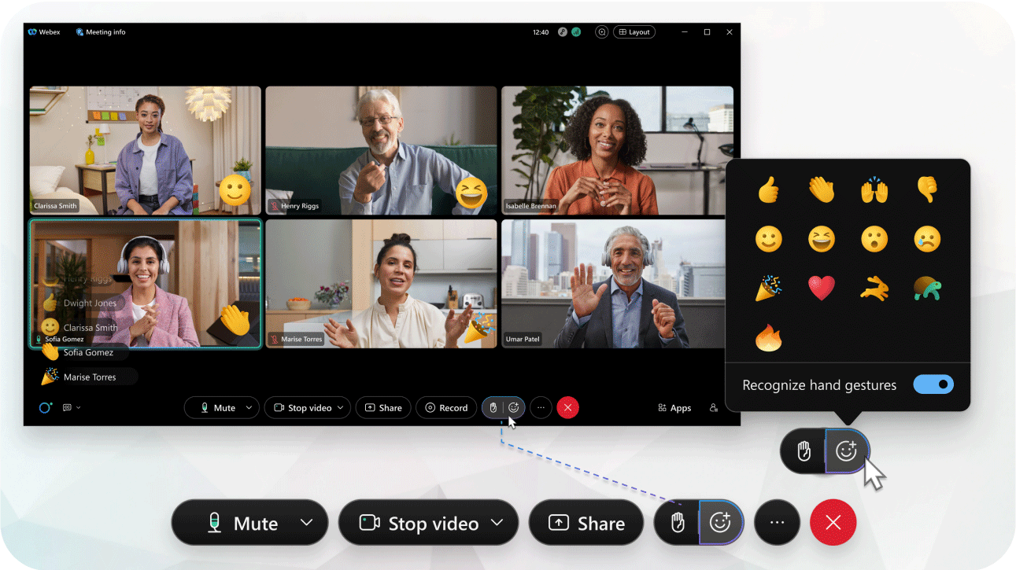
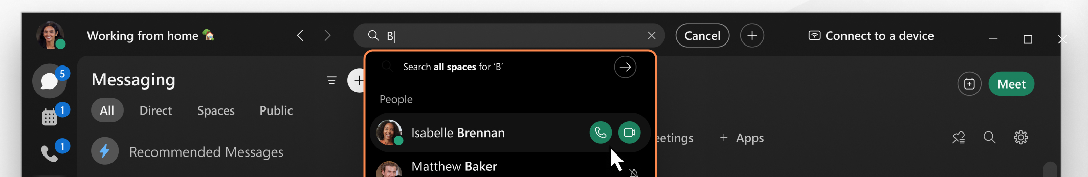
Start connecting with your team
Join and host
productive meetings
Keep work organized
as things progress
Messaging keeps work moving forward.
Send a direct message for quick questions or one-on-one check-ins. Search for, join, or create spaces to bring groups together around a project or topic.
Schedule, start, and see upcoming meetings in the Meetings tab. Tap the Join button when it’s time to meet.
Before joining, preview your camera, and adjust your audio and video settings if needed.
Tip: Blur your background or choose a virtual one to minimize distractions.
As conversations and spaces grow, small habits keep your workspace manageable:
Favorite key spaces to keep them at the top
Group spaces into custom sections by project or team
Hide spaces that need less attention
Peek into active spaces to preview messages without pressure to respond
Looking for something? Use the search bar to find people, messages, files, or links.
Spaces keep conversations, files, and decisions in one place, so everything stays visible to the entire team and easy to find when you need it.
Once you’re in the meeting, you can mute and unmute yourself, share your screen, chat, react, or turn on captions.
Tip: If you're hosting, hit record so others can catch up or revisit what was discussed.
Don’t forget to use threaded replies and @mentions to keep conversations organized and draw attention where needed.

Slide 6




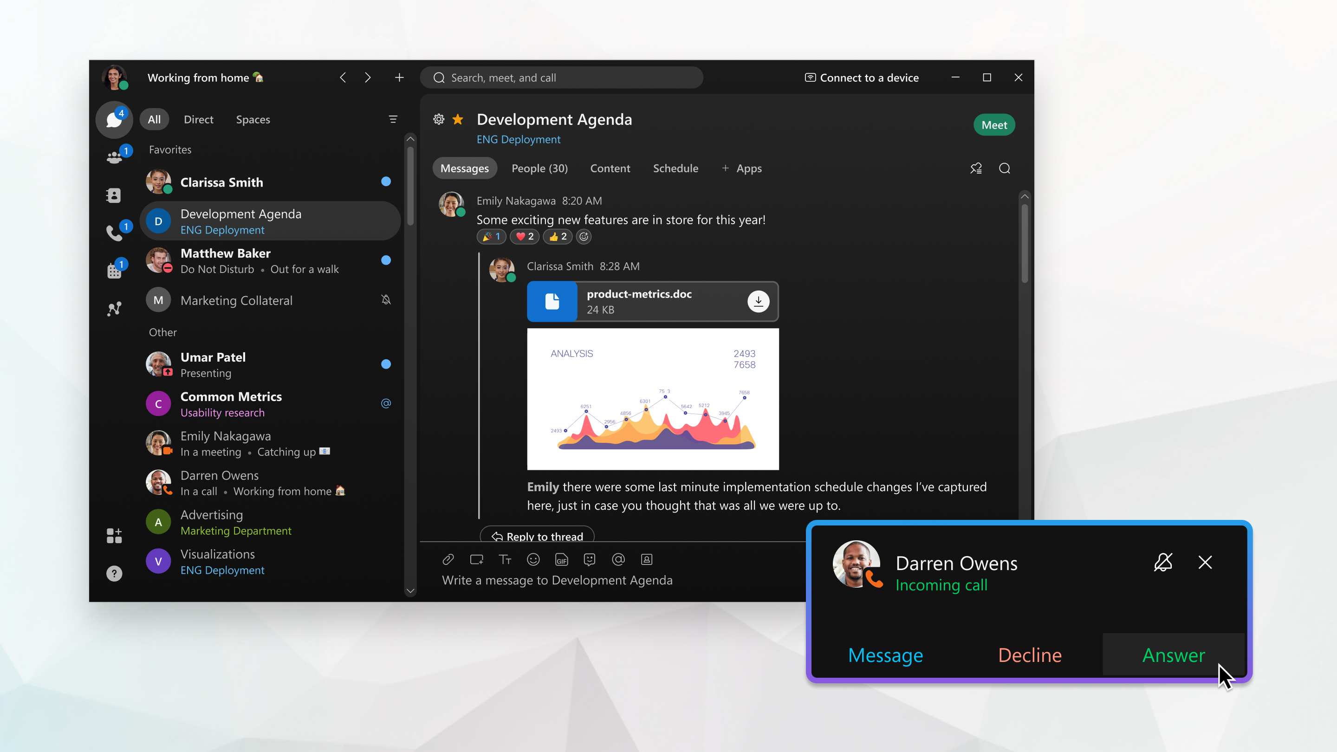
Your checklist for getting started
Make and manage calls with confidence
Stay on top of it all
with AI Assistant
Your business number works across the Webex app and your devices. Review and manage your call settings from your profile.
From the Calling tab, review your call history and easily make calls from the dial pad.
Incoming calls appear across the Webex app and your connected devices.
Once enabled by your admin, AI Assistant helps you save time and stay informed easily.
In Meetings:
Running late or stepped away? Ask for a recap of what you missed
Identify action items or check if your name was mentioned
After the meeting, get summaries and key decisions without watching the recording
In Messaging:
Summarize long threads to catch up quickly
Rewrite messages to adjust tone or clarity
Translate messages in real time when working across languages
In Calling:
Get summaries of recorded calls so you can review key points and follow-up quickly
Download the Webex app on your computer and mobile device.
Connect your calendar to sync your availability and join meetings with one click instead of searching email invites.
Edit your profile and upload your photo so colleagues can easily find you by name.
Send a direct message to someone you already know as a low-pressure way to test messaging features.
Search for and join a space that's relevant to your work to see how teams use spaces.
Explore calling settings from your profile to set up your voicemail and have calls reach you the way you want.
You’re off to a great start! Whether you're managing calls, leading meetings, or keeping projects moving in spaces, everything works together to help you work your best.
While on a call, you can mute, hold, transfer, or add someone without disruption.
If you miss a call, voicemail has you covered with options for easy follow-up.

Slide 7

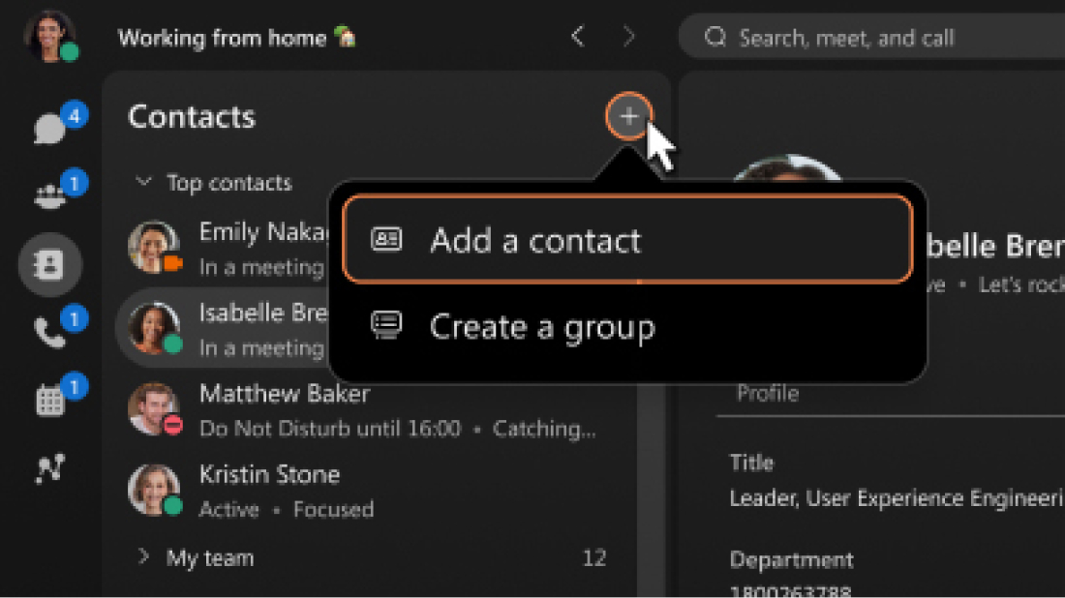
A better way to communicate
Webex Calling connects your business number across devices so you can make and receive calls wherever your workday takes you.
Keep all your work
in one place
Edit your
calling settings
Incoming calls may ring on your desk phone, in the app, or across multiple devices.
This flexibility makes it easier to stay connected wherever you are.
If you frequently contact the same people, add them to your contacts list so they’re just a click away on the Contacts tab.
Use the Webex app for the best experience.
Whether you take calls from your computer or desk phone, everything is tied to the same number, so people reach you the same way every time.
Review and manage your calling settings from your profile to reduce interruptions and ensure calls go where they need to.
Depending on your setup, you can manage voicemail, call forwarding, caller ID, and more.
Download the app
Manage calls
From the Calling tab, access your dial pad and recent call history, to easily place a call from your computer or return a missed call.
You can make calls using the on-screen dialer by typing a name or number. Calls made from the app use your work number, just like calls from a desk phone.

Slide 8


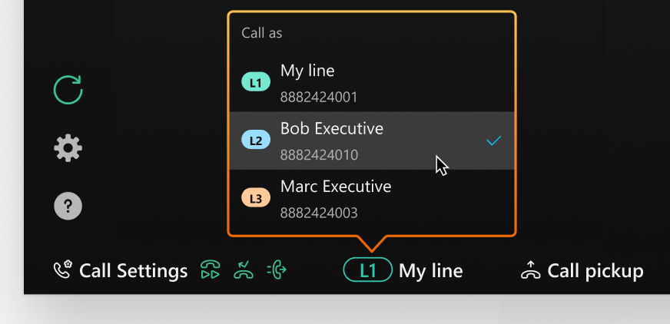
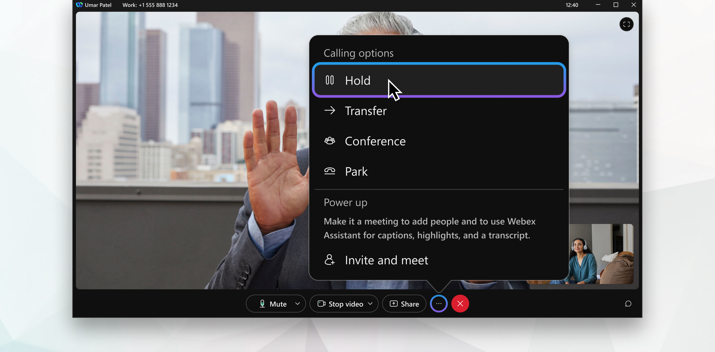
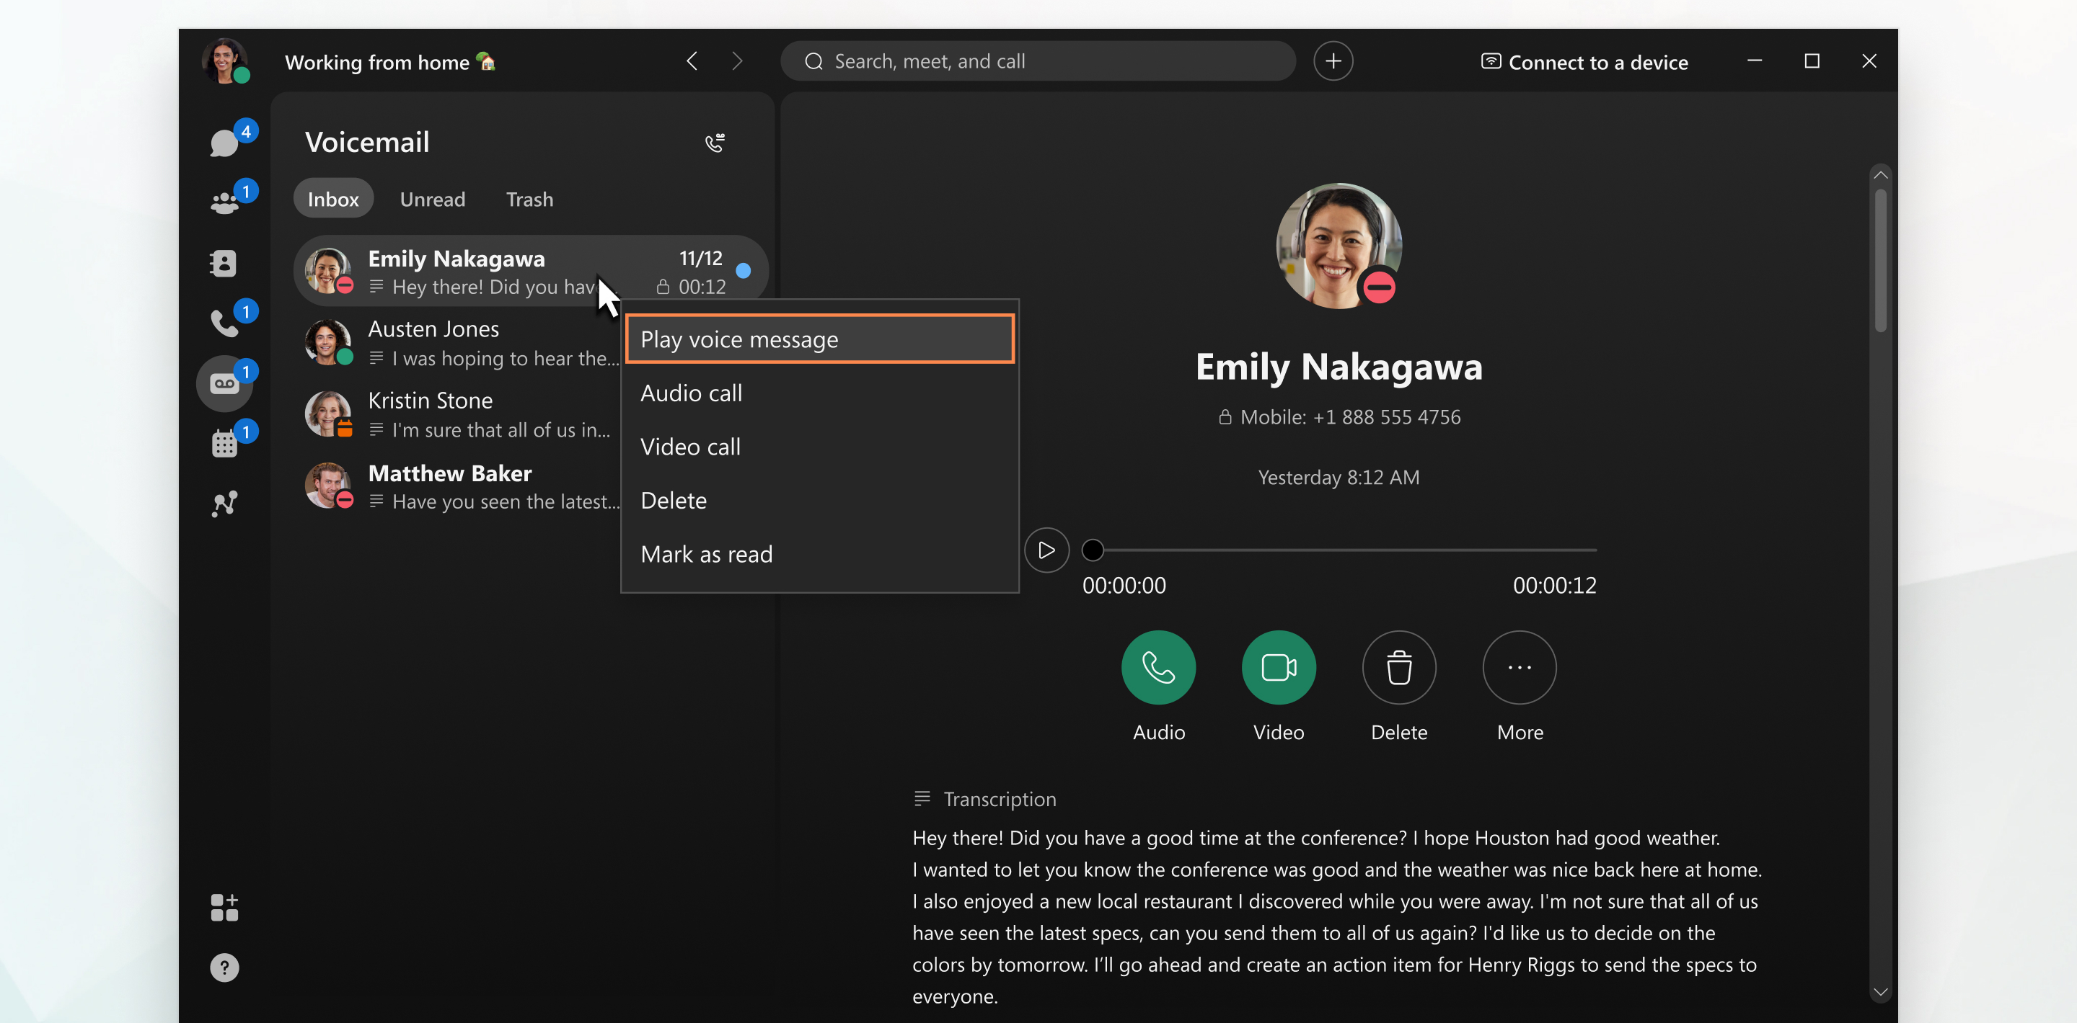
Manage calls as conversations evolve
Shared call handling across teams
Stay connected
when you’re away
While you’re on a call, built-in controls in the call window help you respond naturally as needs change.
Mute yourself, place someone on hold while you check information, or transfer them to the right person.
Need backup? Conferencing allows others to join the conversation quickly.
If your team shares call handling, the call window lets you park calls for yourself or a colleague to retrieve, keeping coverage seamless when you're away from your desk or others are busy.
Need calls to reach you somewhere else? Forward them to another number from calling settings under your profile.
Voicemail has you covered if you miss a call. Play back messages or read the transcript when you can't listen.
If you need to follow up, you can call back with a click.
If your profile is assigned multiple lines with different phone numbers, you can choose which one to call from directly in the dial pad.

Slide 9

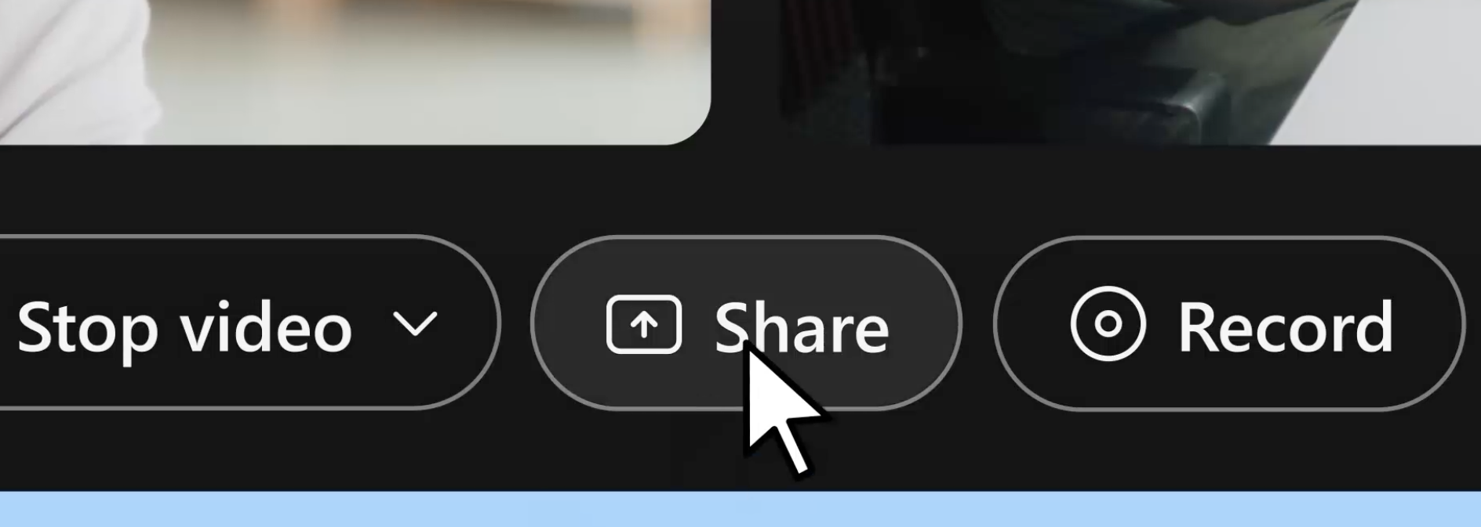
A better way to meet
Meetings don't have to slow you down. Connect quickly, stay engaged, and leave knowing what’s next, whether you're joining, hosting, or jumping in last minute.
Keep all your work
in one place
View and
join meetings
Keep conversations focused
Use the Webex app for the best experience.
After you install the app and sign in, you can host, join, and participate in meetings.
No need to search your inbox—see your scheduled meetings from the Meetings tab. Click the Join button when it’s time to meet.
Tip: Connect your calendar to sync meetings and availability automatically.
Once the meeting starts, controls appear at the bottom of the meeting window.
Use Mute to reduce unnecessary interruptions. When unmuted, background noise is automatically filtered out.
Visuals help boost engagement and understanding. Select Share and choose your entire screen or a specific application.
Download the app
Check your setup
Before joining, preview your camera and adjust the audio and video settings if needed.
Clutter can be distracting. Blur your background or choose a virtual one from the video settings.

Slide 10



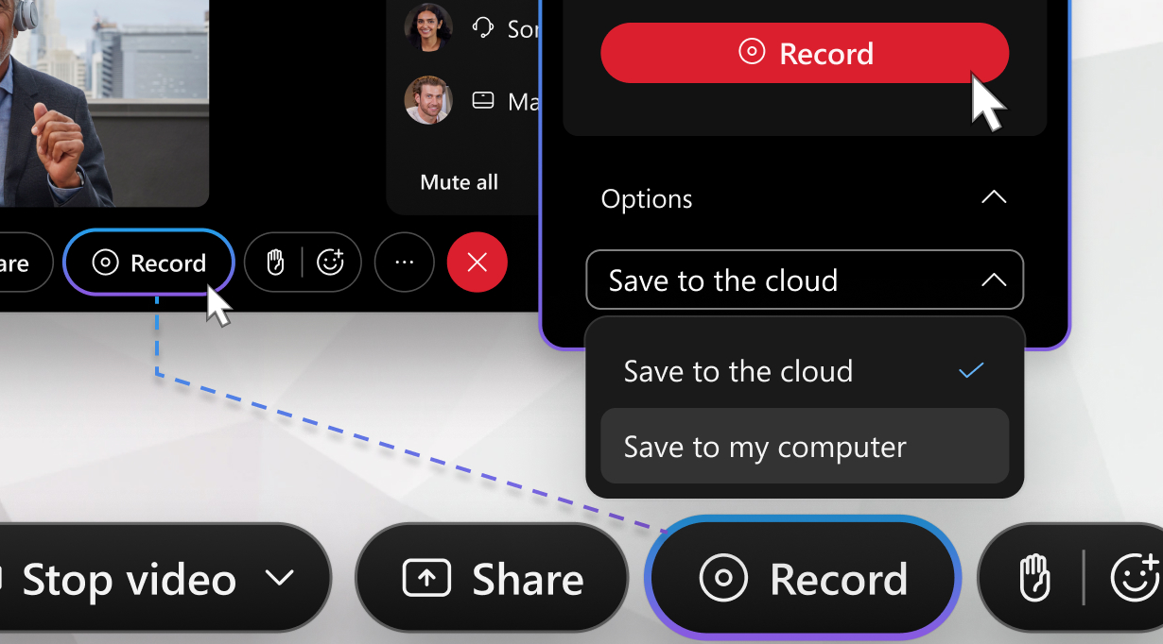
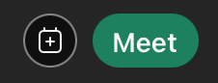
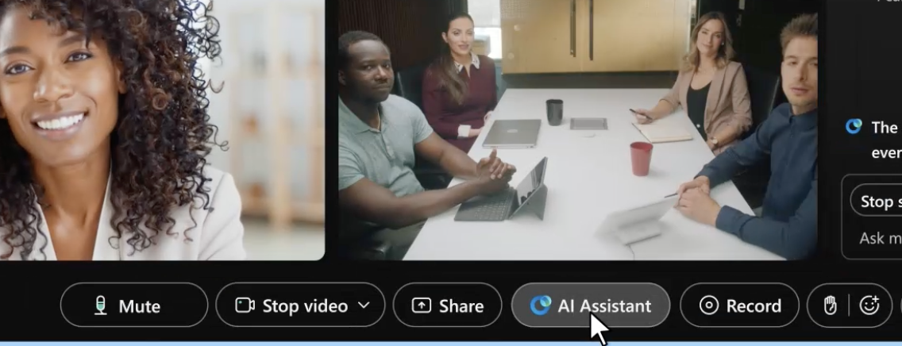
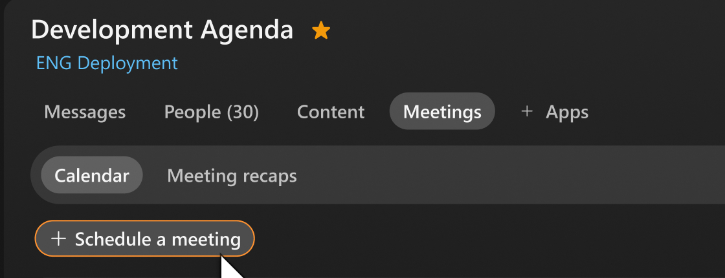
Make it easy for
others to participate
Capture notes
and action items
Start and schedule meetings with ease
Meetings work better when everyone can participate, no matter where they're joining from or how they prefer to engage.
Raise your hand to share without interrupting or use gestures and reactions to show support.
Accessibility is important. Meeting hosts can turn on closed captions from the meeting controls so everyone can follow along.
Meeting hosts can record meetings so discussions and decisions can be shared or revisited later.
When you need to meet right away, use your personal room. Share your dedicated meeting link or launch it from the Meetings tab for quick check-ins or impromptu discussions.
For planned meetings, schedule from the Meetings tab or use integrations with calendars like Microsoft Outlook.
And when meetings move fast, AI Assistant helps you stay on track without taking your attention away from the discussion.
During a meeting, you can catch up if you step away or join late, identify action items, or check whether your name was mentioned.
Tip: For recurring meetings or ongoing projects, schedule the meeting series in a Webex space to keep all your work together.

Slide 11

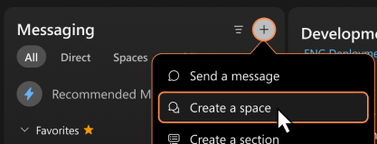
A better way to work together
Webex Messaging gives teams one place to communicate, share,
and keep work moving forward.
Keep all your work
in one place
See what’s happening
Keep work organized
in spaces
Use the Webex app for the best experience.
After you install the app and sign in, you can start messaging and using spaces right away to connect with teammates, ask questions, and track progress.
See your conversations from the Messaging tab.
Notifications and recent conversations appear at the top, making it easier to see updates, active discussions, and items that may need your attention.
Spaces bring people, messages, and shared content together around a project, topic, or team.
This keeps everyone aligned and creates a reliable record of decisions and progress.
You may be added to spaces directly, or a team that gives you access to related spaces.
You can also search for a public space by name or topic or create a new space if what you’re looking for doesn’t exist.
Download the app
Send messages
Sometimes you need a quick way to connect. You can send direct messages from the Messaging tab or by searching and selecting a person’s name.

Slide 12


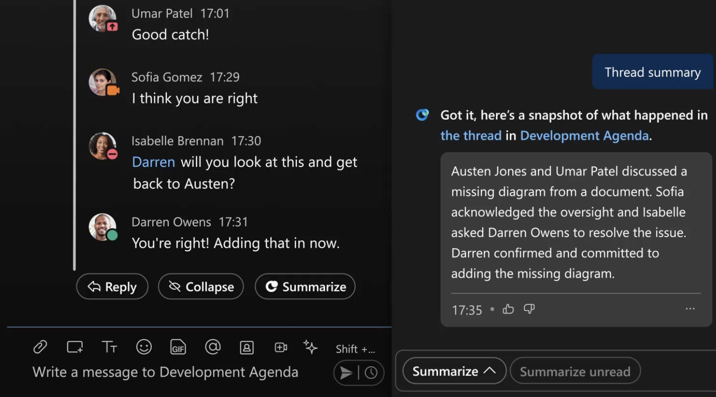
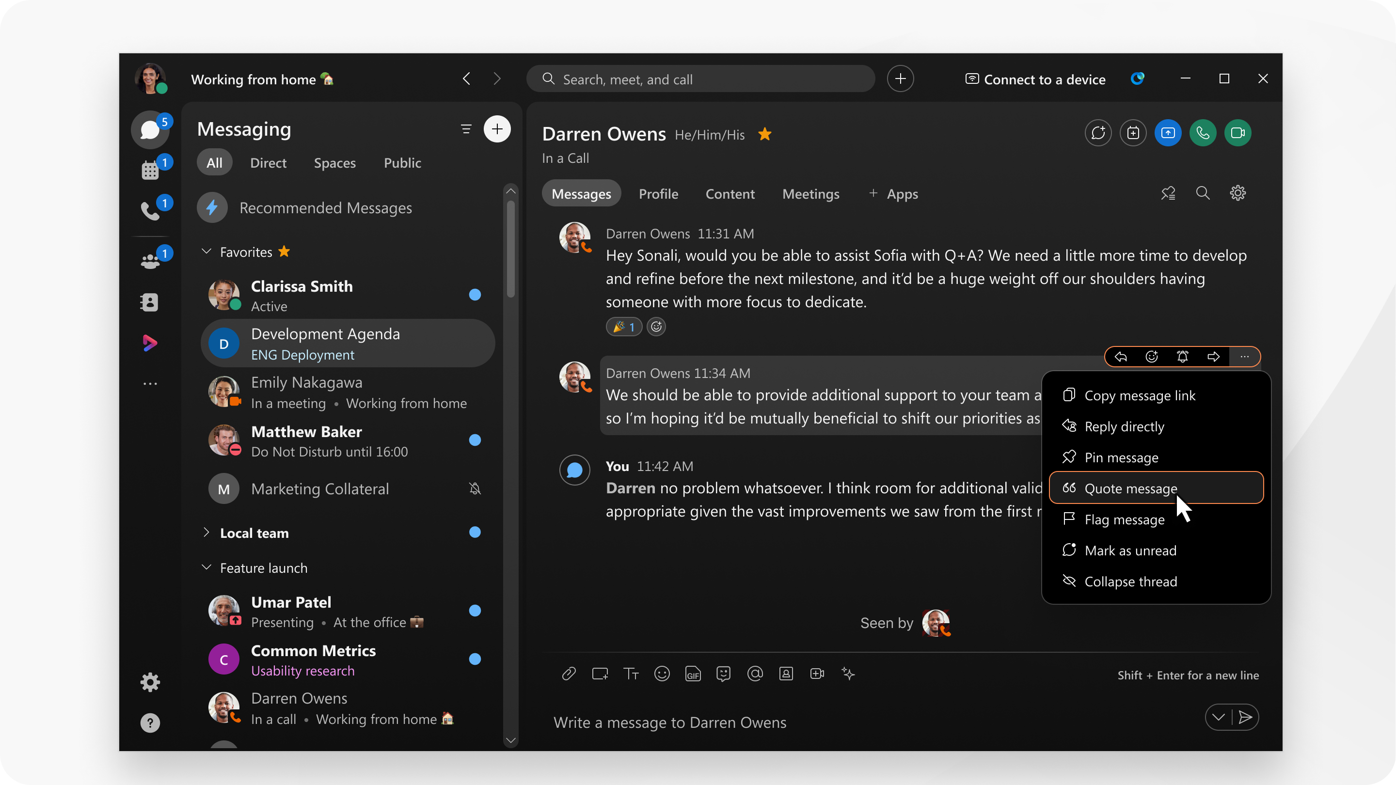
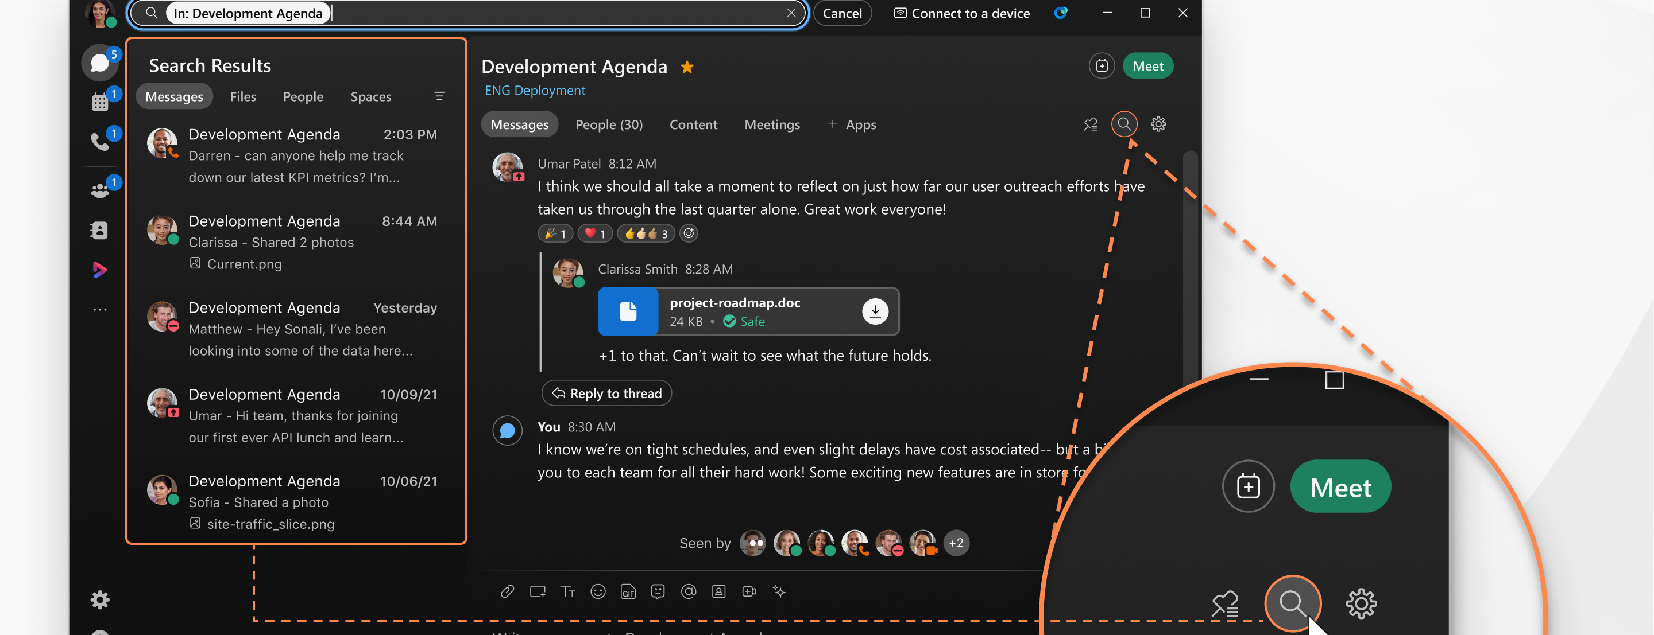
Keep conversations clear and focused
Make messages easier to understand
When spaces get busy, AI Assistant helps you catch up without reading every message. Get summaries of long threads, see key decisions, and surface action items so you're up to speed, even if you're joining late or returning after time away.
Keep related conversations together so context isn't lost. Quote a message or reply directly to a message to start a thread.
Make your messages clear and easy to scan. Use bold text, lists, emojis, or GIFs to add structure and tone. Attach files or screen captures for additional context.
Need help drafting a message? AI Assistant can rewrite messages before you hit send. Make them more concise or adjust the tone, without spending extra time editing.
Find information
more easily
Stay organized
Need someone's input? Use @mentions to draw attention so the right people stay informed.
This keeps busy spaces organized and makes it easier to find decisions and details later.
Use the search bar at the top of the app or the search within a space to quickly find messages, shared files, and links.
As spaces and conversations grow, small habits keep your workspace manageable.
Favorite spaces to keep them at the top, hide spaces that you don’t participate in, and set your notification preferences.

